Slide 1
HKCT 290DS003
網站框架開發助理證書課程 290DS003
组員姓名學号

Slide 2
操作系统：Linux Ubuntu
开发工具：Visual Studio Code
Web框架：Django
数据库：PostgreSQL
数据库工具: PQAdmin
其他开发语言：html+css+javascript

Slide 3
主要功能 :
查閱自己借閱圖書嘅情況
- 巳借閱圖書
- 查閱過期書和支付罰款
- 書籍尋找 , 預約和自己指定到那圖書館提取

Slide 4
其他功能
1.註冊
2. 修改密碼
3. 忘記密碼

Slide 5
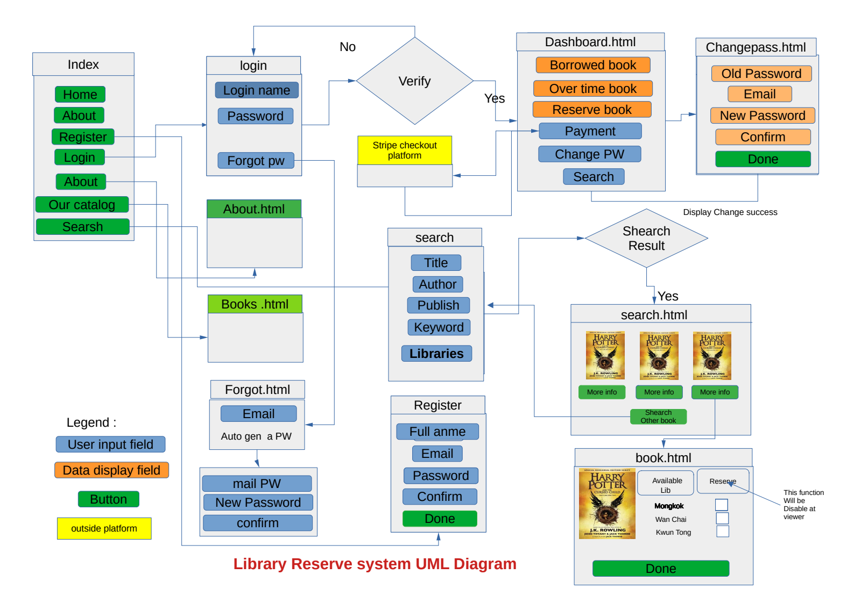

Slide 6
Web Function introduce
1. 動態處理圖書館，借閱條款 和 Top Bar 的資料
2. 支付系統，利用第第三方支付程式,直接支付過期罰款
3. 忘記密碼時用家只需輸入EMAIL.並按下重置按鈕,系統自動產生密碼並發送到用家Email。
4. 系統可以自動甄選,。不會為未有登錄或未注冊人事, 提供預借服務

Slide 7
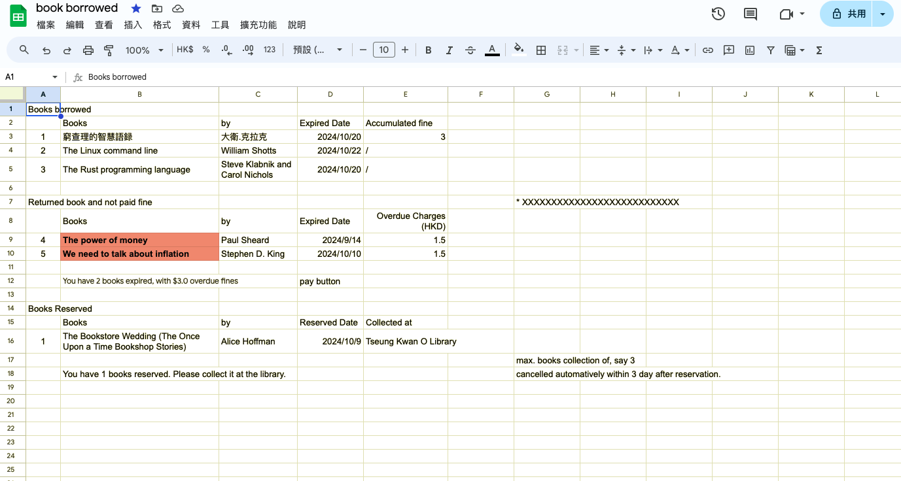

Slide 9
Data Base Relationship diagram

Slide 10
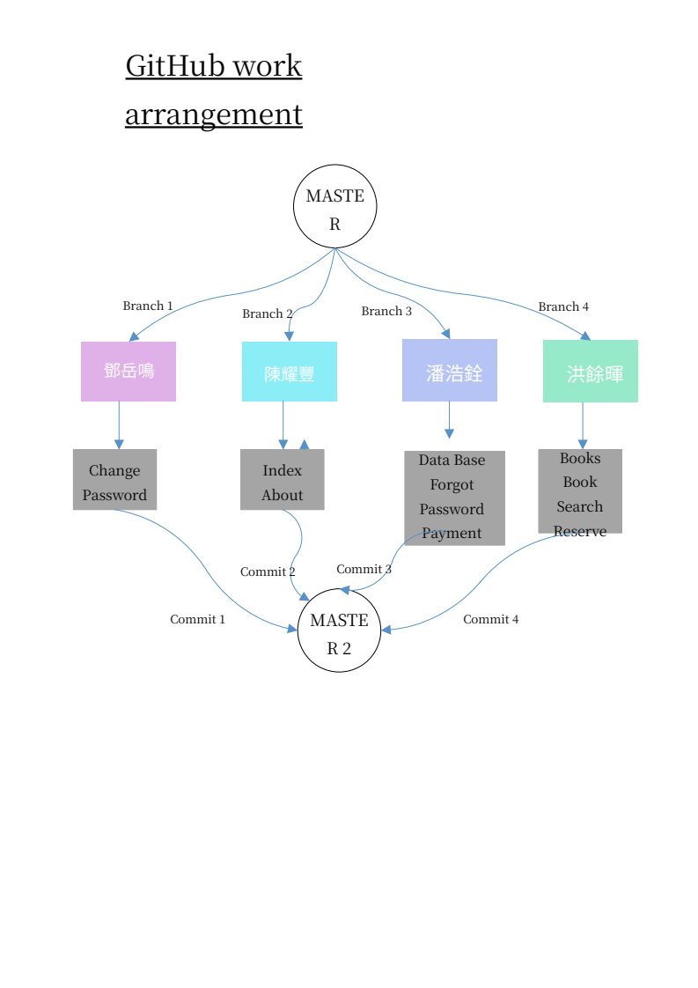

Slide 11
Dynamic function introduce

Slide 12
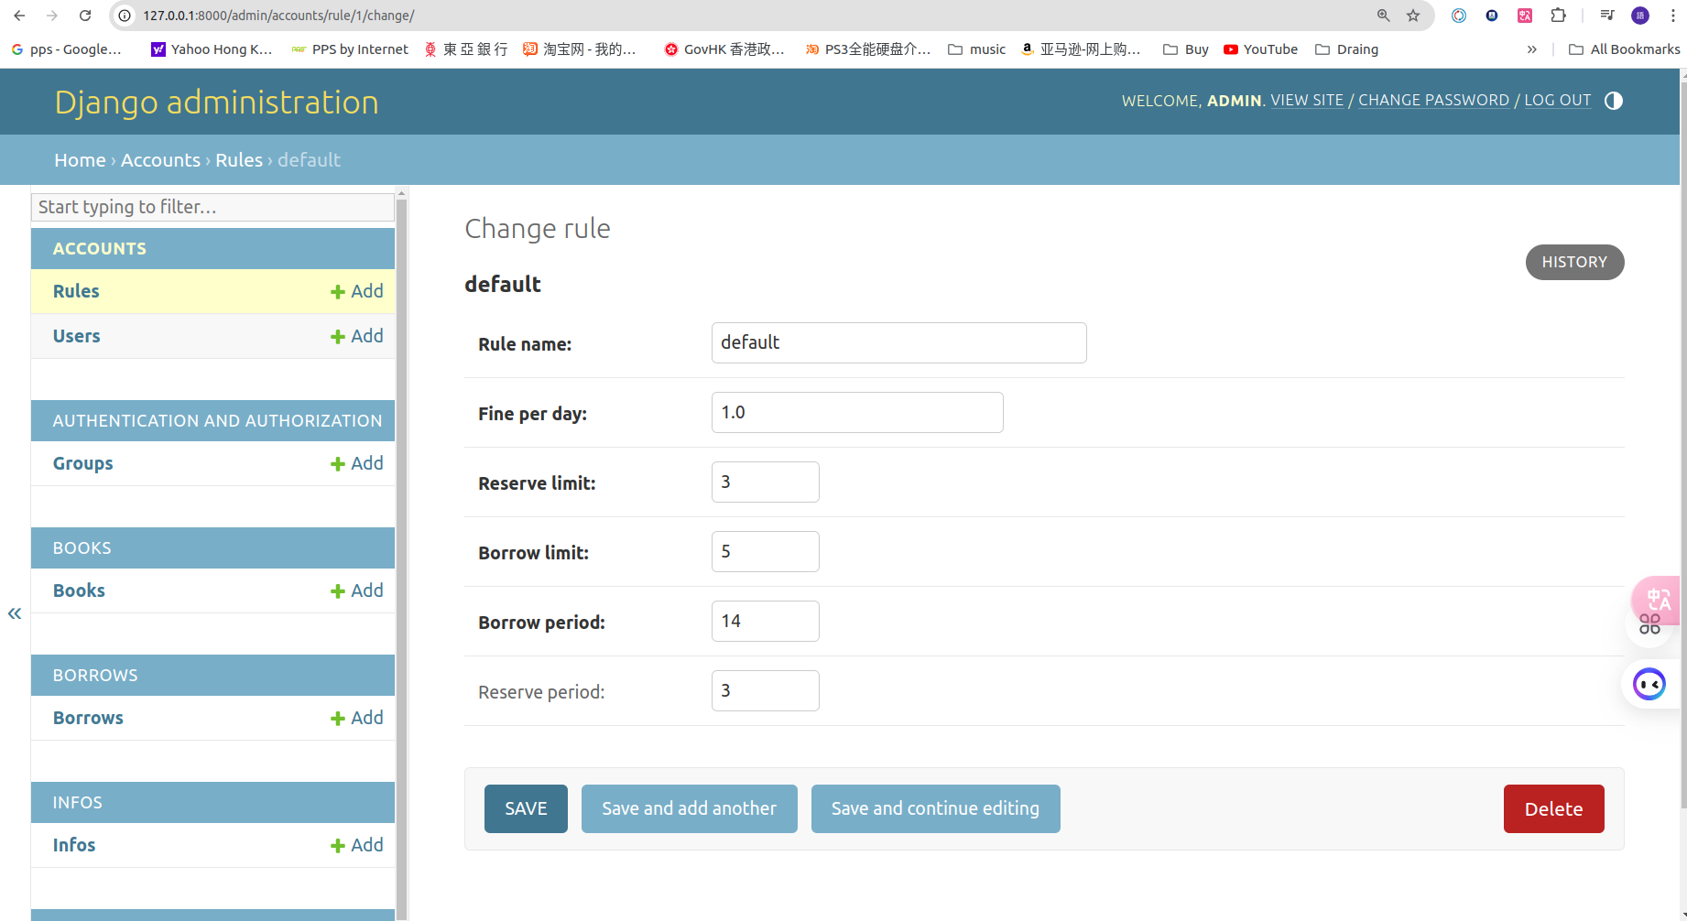

Slide 13
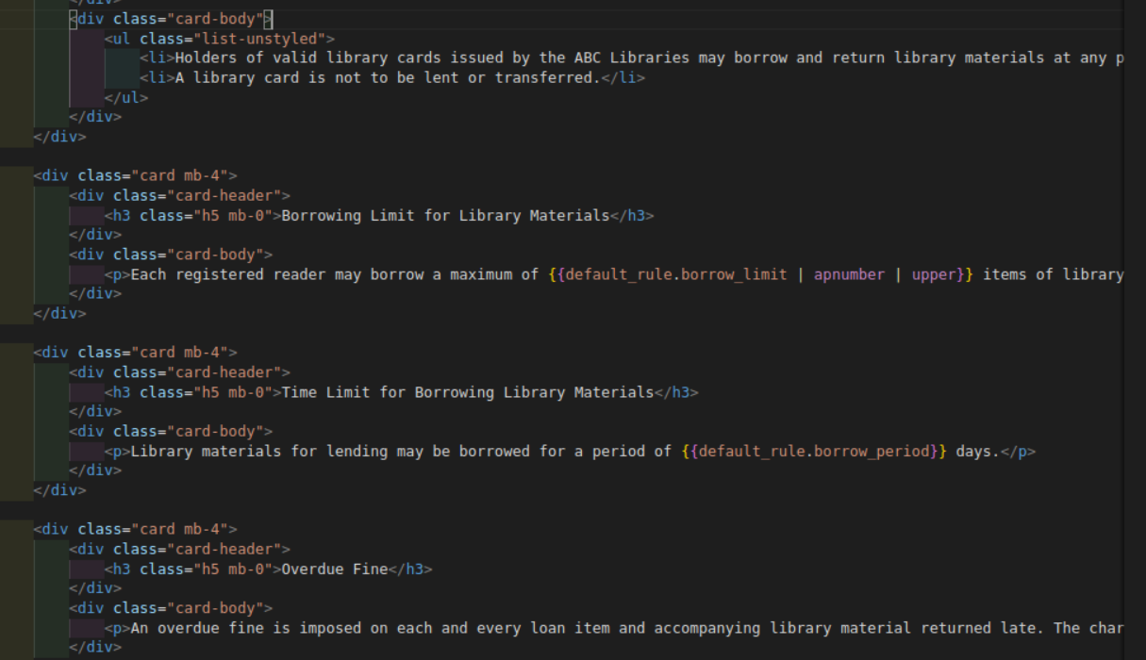

Slide 14
Data Base introduce

Slide 15
How to import data in our table through pgadmin?
pgadmin vs. Django default admin

Slide 16
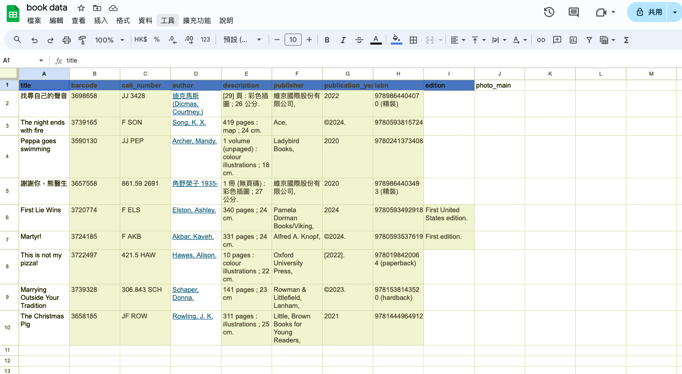

Slide 17
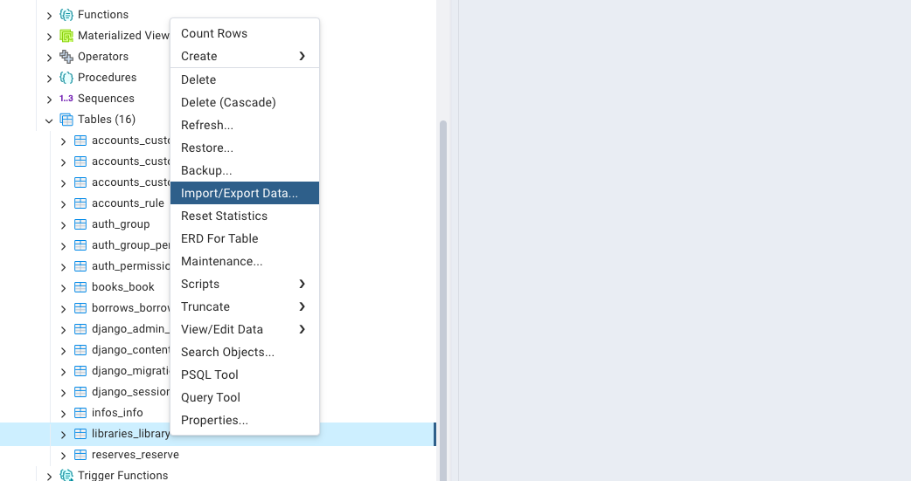
go to your assign table, double click and select import
Be careful, the column shown in here shall match with those in your models.
BUT PHOTO_MAIN HAS TO BE INPUT IN DJANGO ADMIN

Slide 18
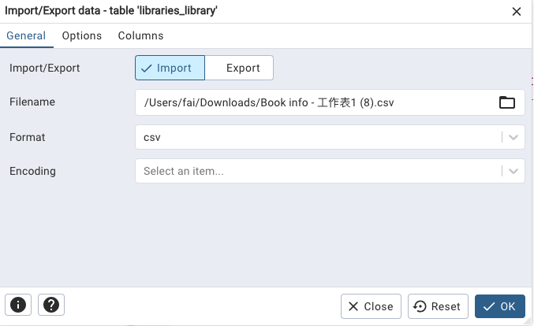
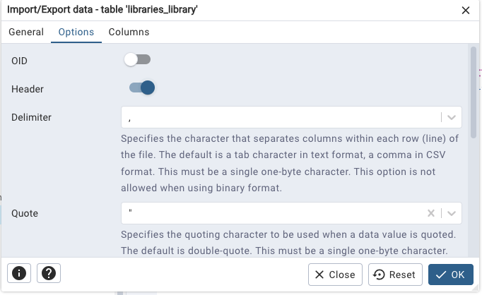
Choose your file saved in csv format
click your header on and enter

Slide 19
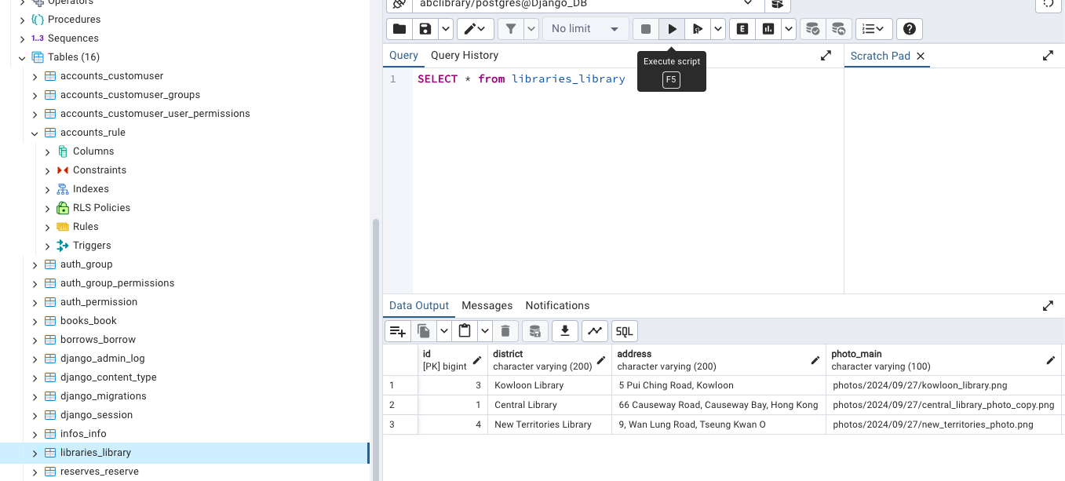
Click the query button, type in:
SELECT * from libraries_library
your data from this library is shown here
data will be update in your postgres server.

Slide 20
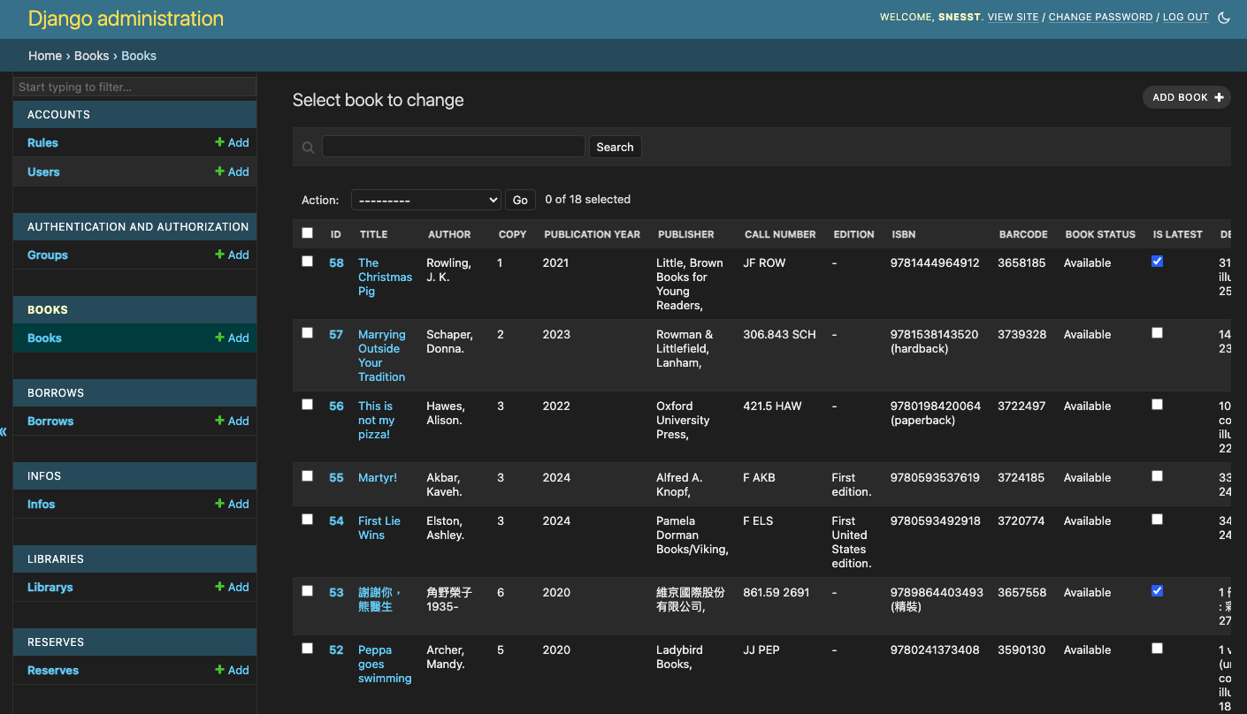

Slide 21
Show the content after searching for a specific book
prepare a template html file; create a card in the right of the book page
make a grab the specific book data, like ‘library’
submit button to reserve.
a message will pop up

Slide 22
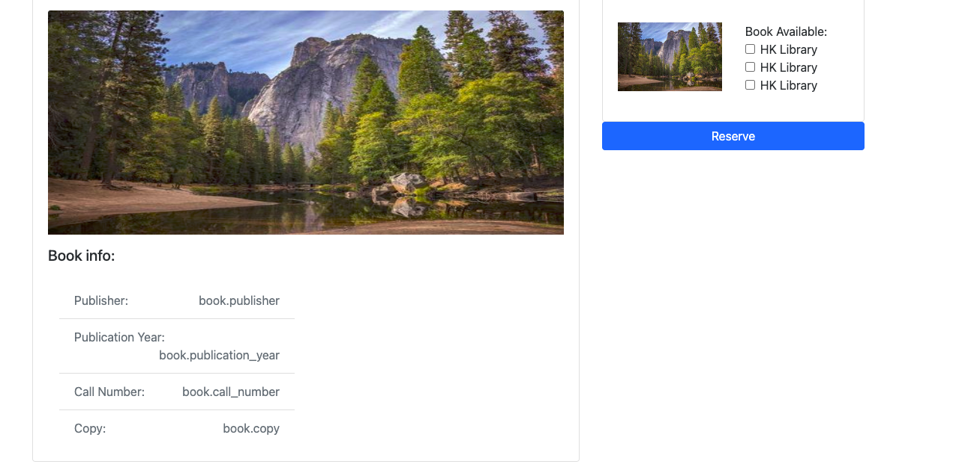

Slide 23
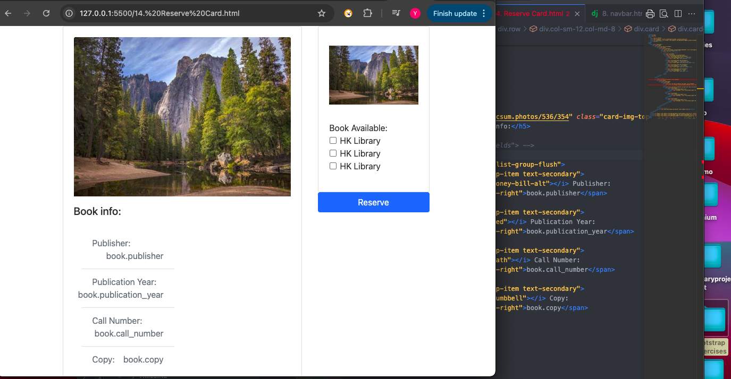

Slide 24
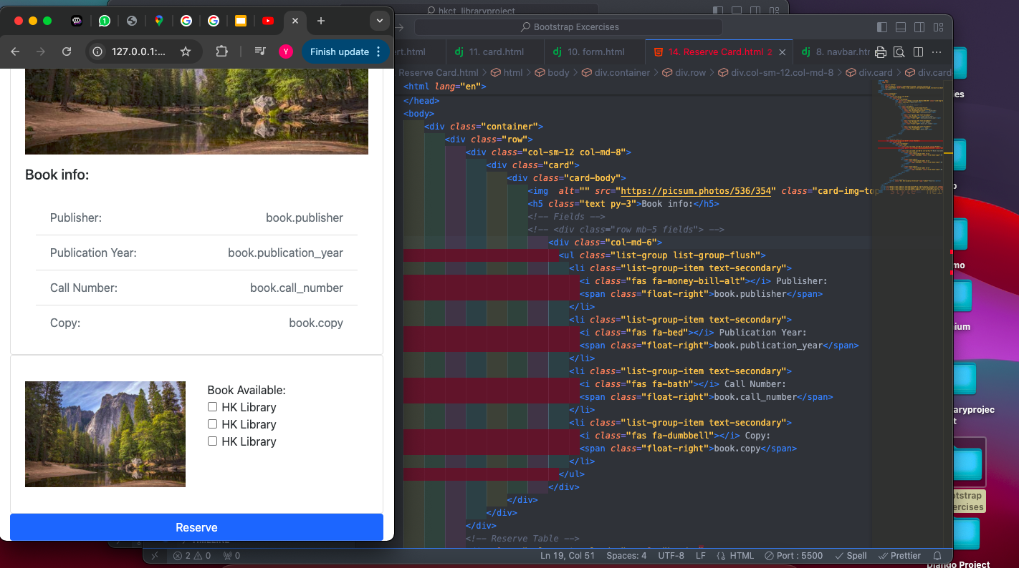
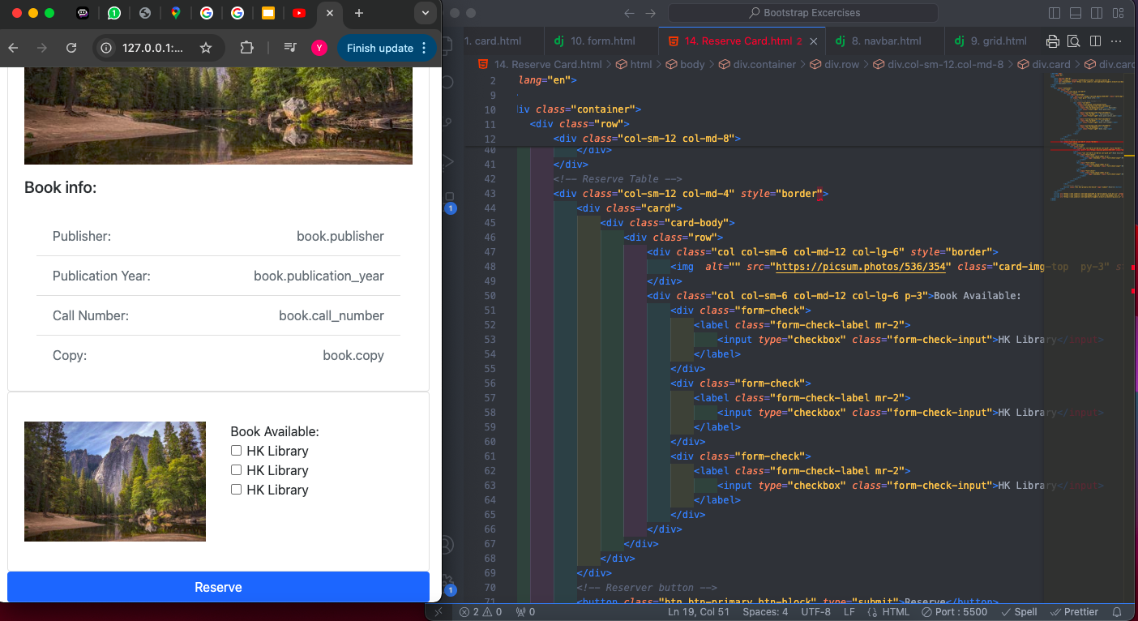

Slide 25
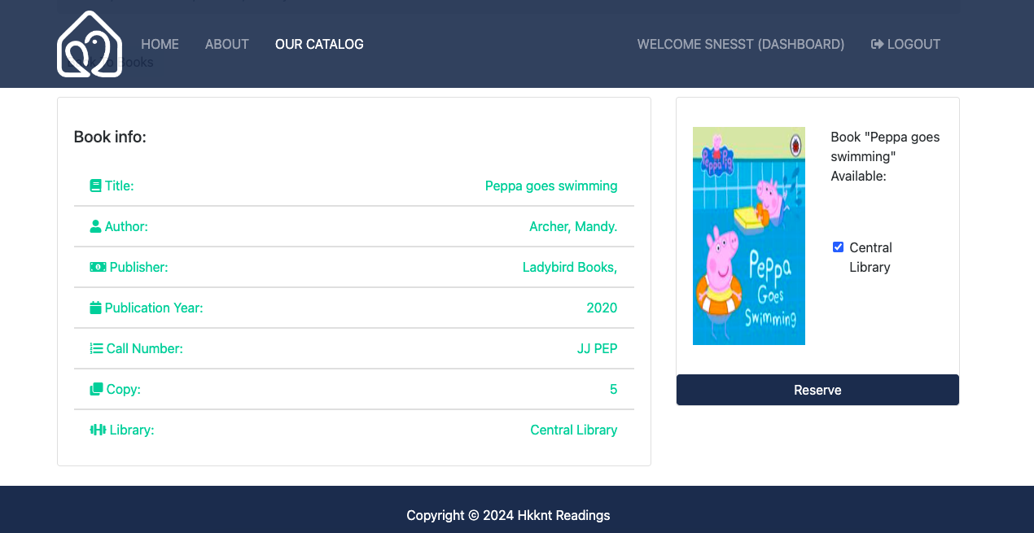
Reserve button and checkbox is active after login

Slide 26
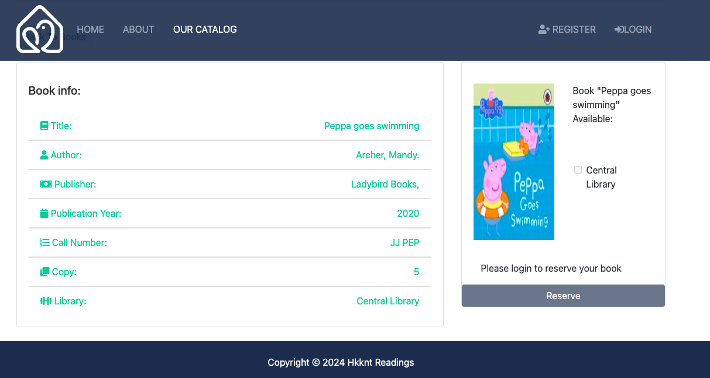
checkbox and Reserve is disable before login

Slide 27
Forget Password introduce

Slide 28
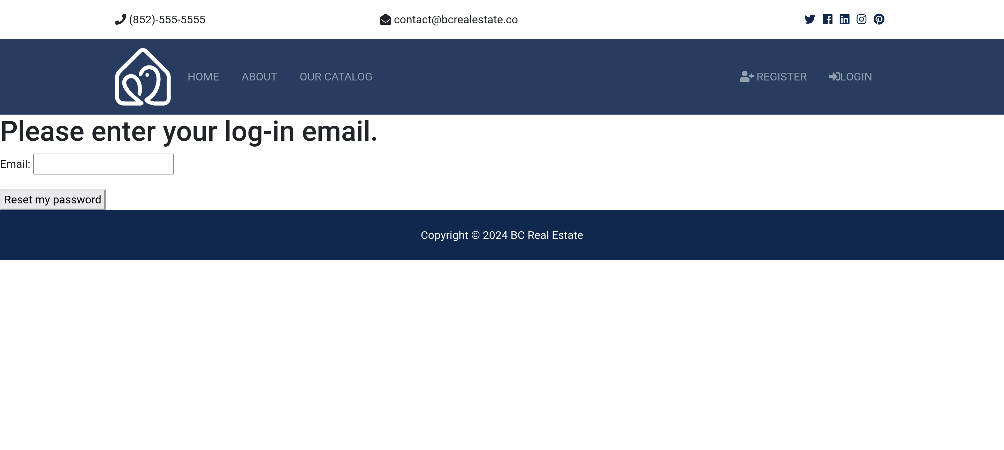

Slide 29
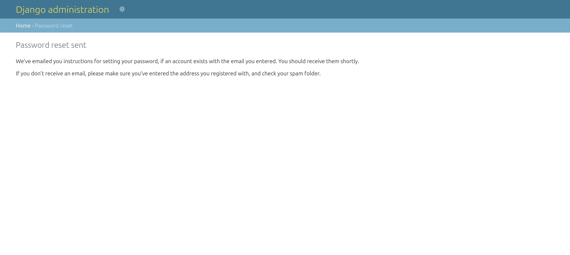

Slide 30
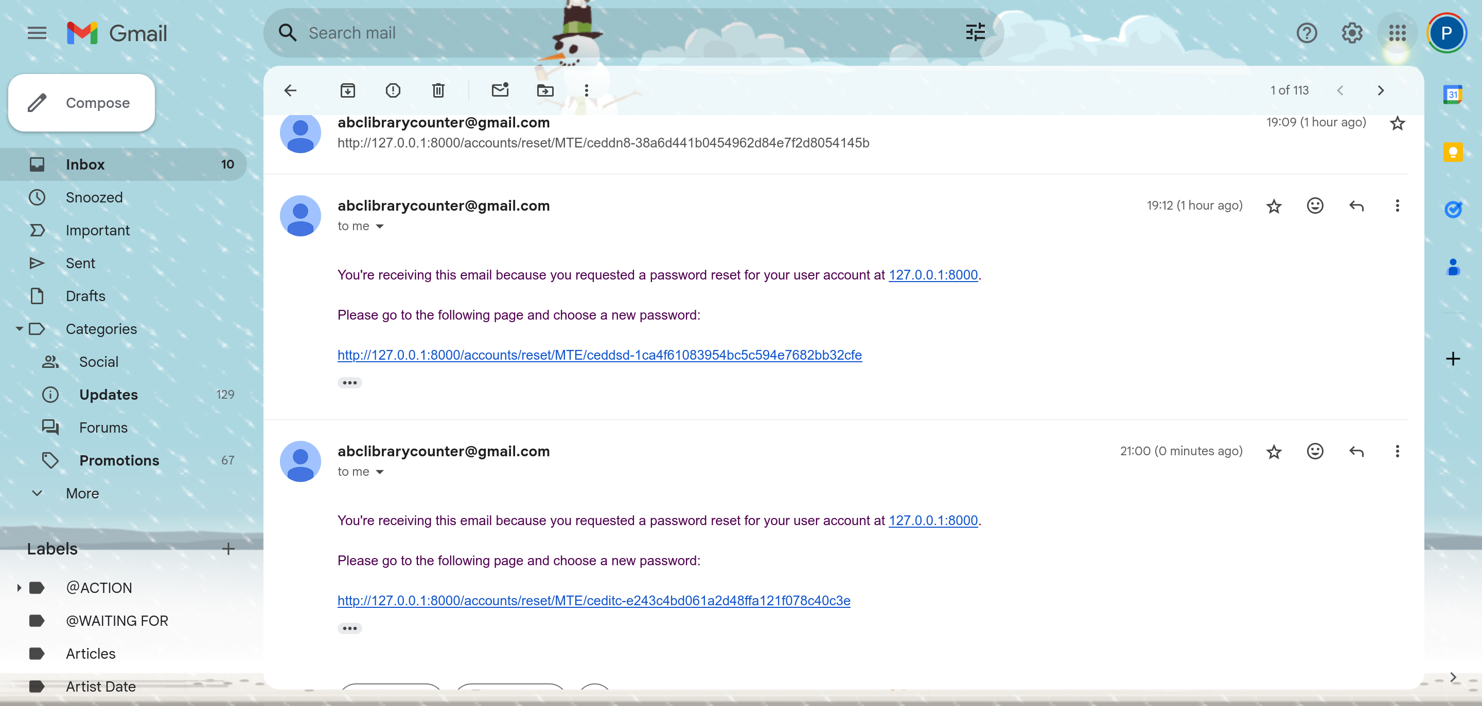

Slide 31
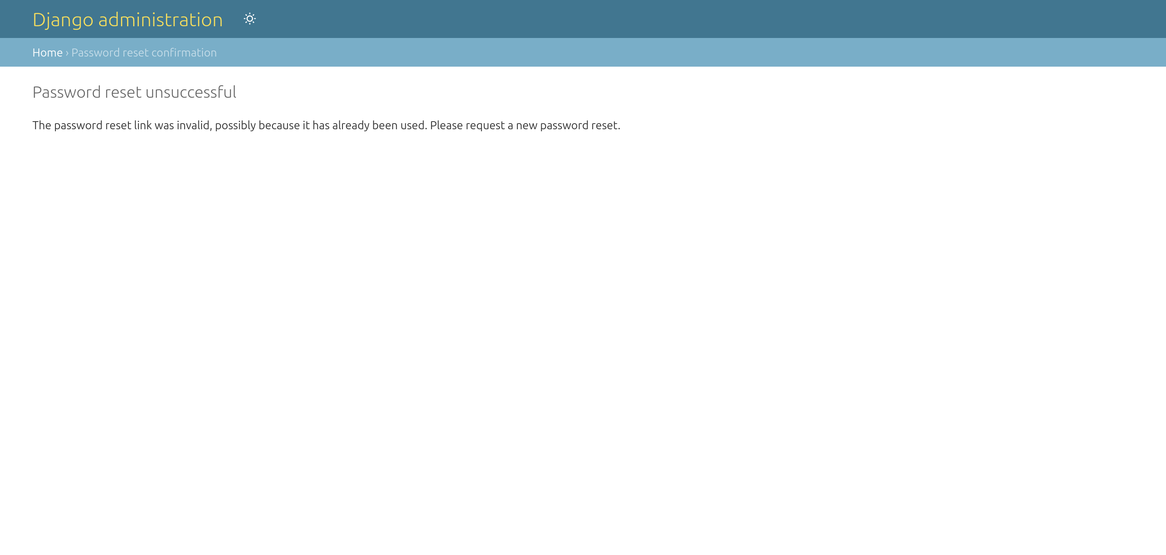

Slide 32
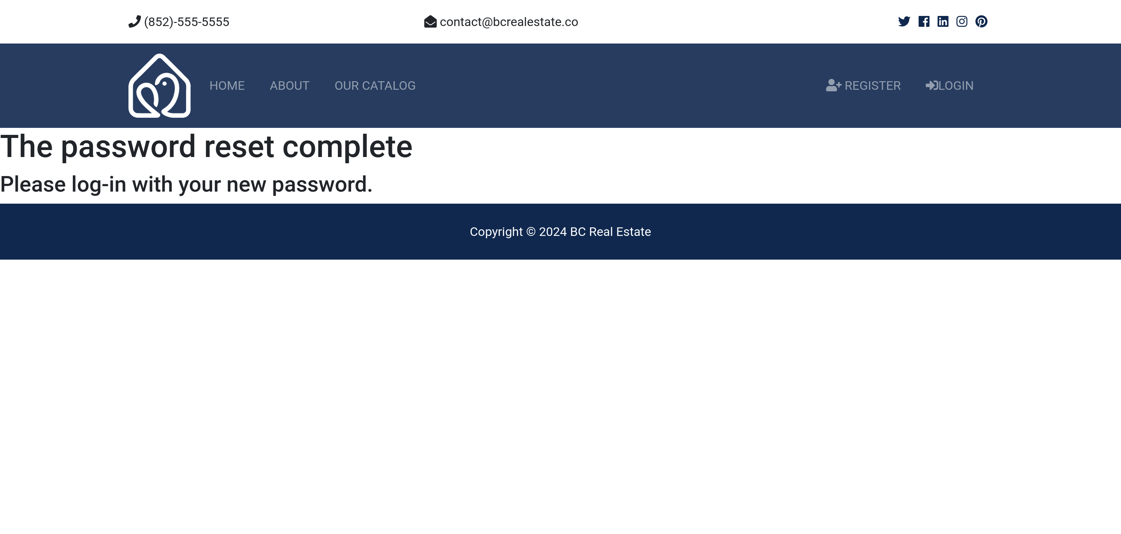

Slide 33
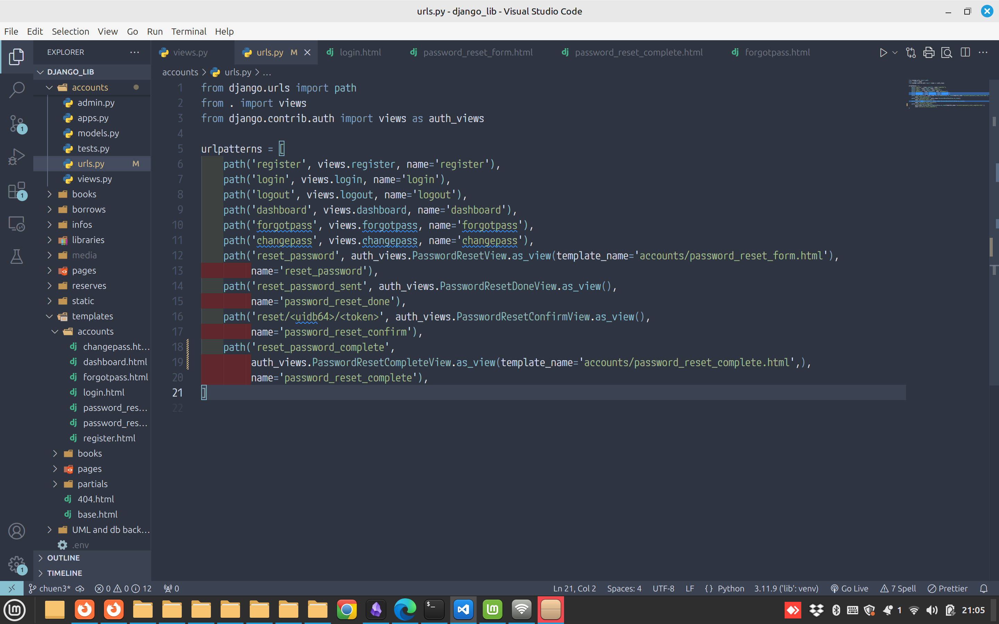

Slide 34
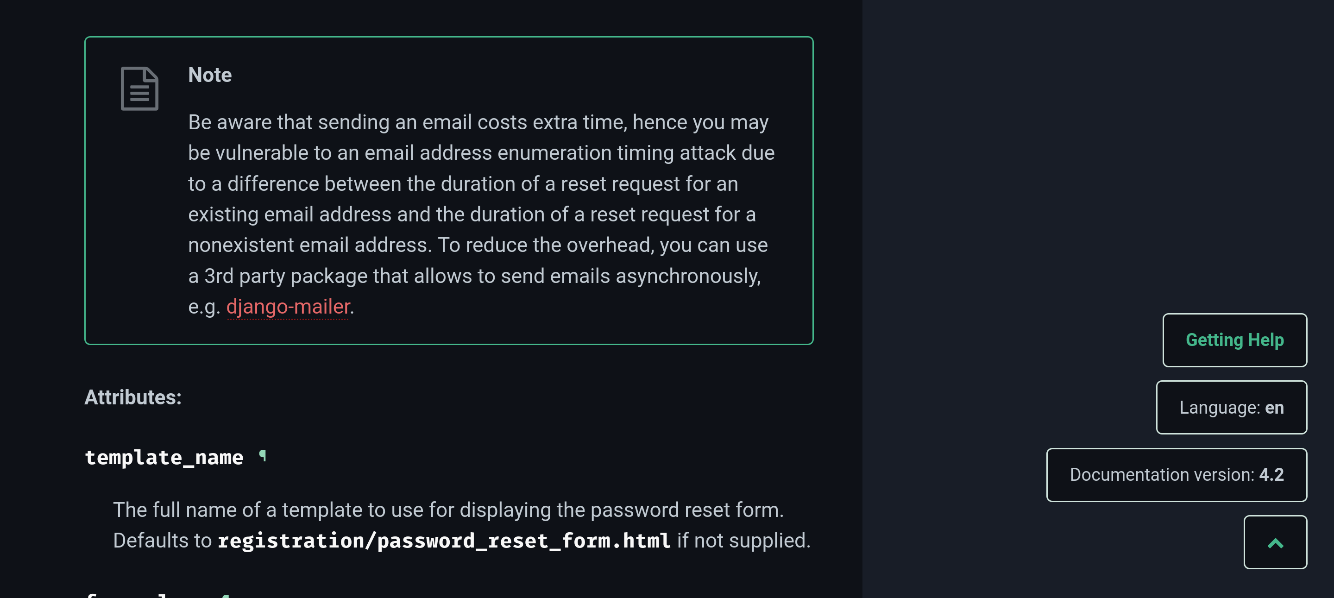

Slide 35
Payment system introduce

Slide 36
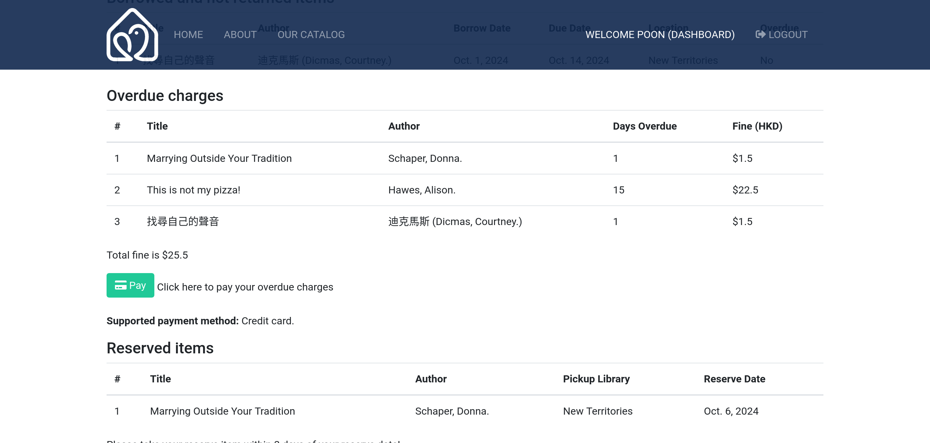

Slide 37
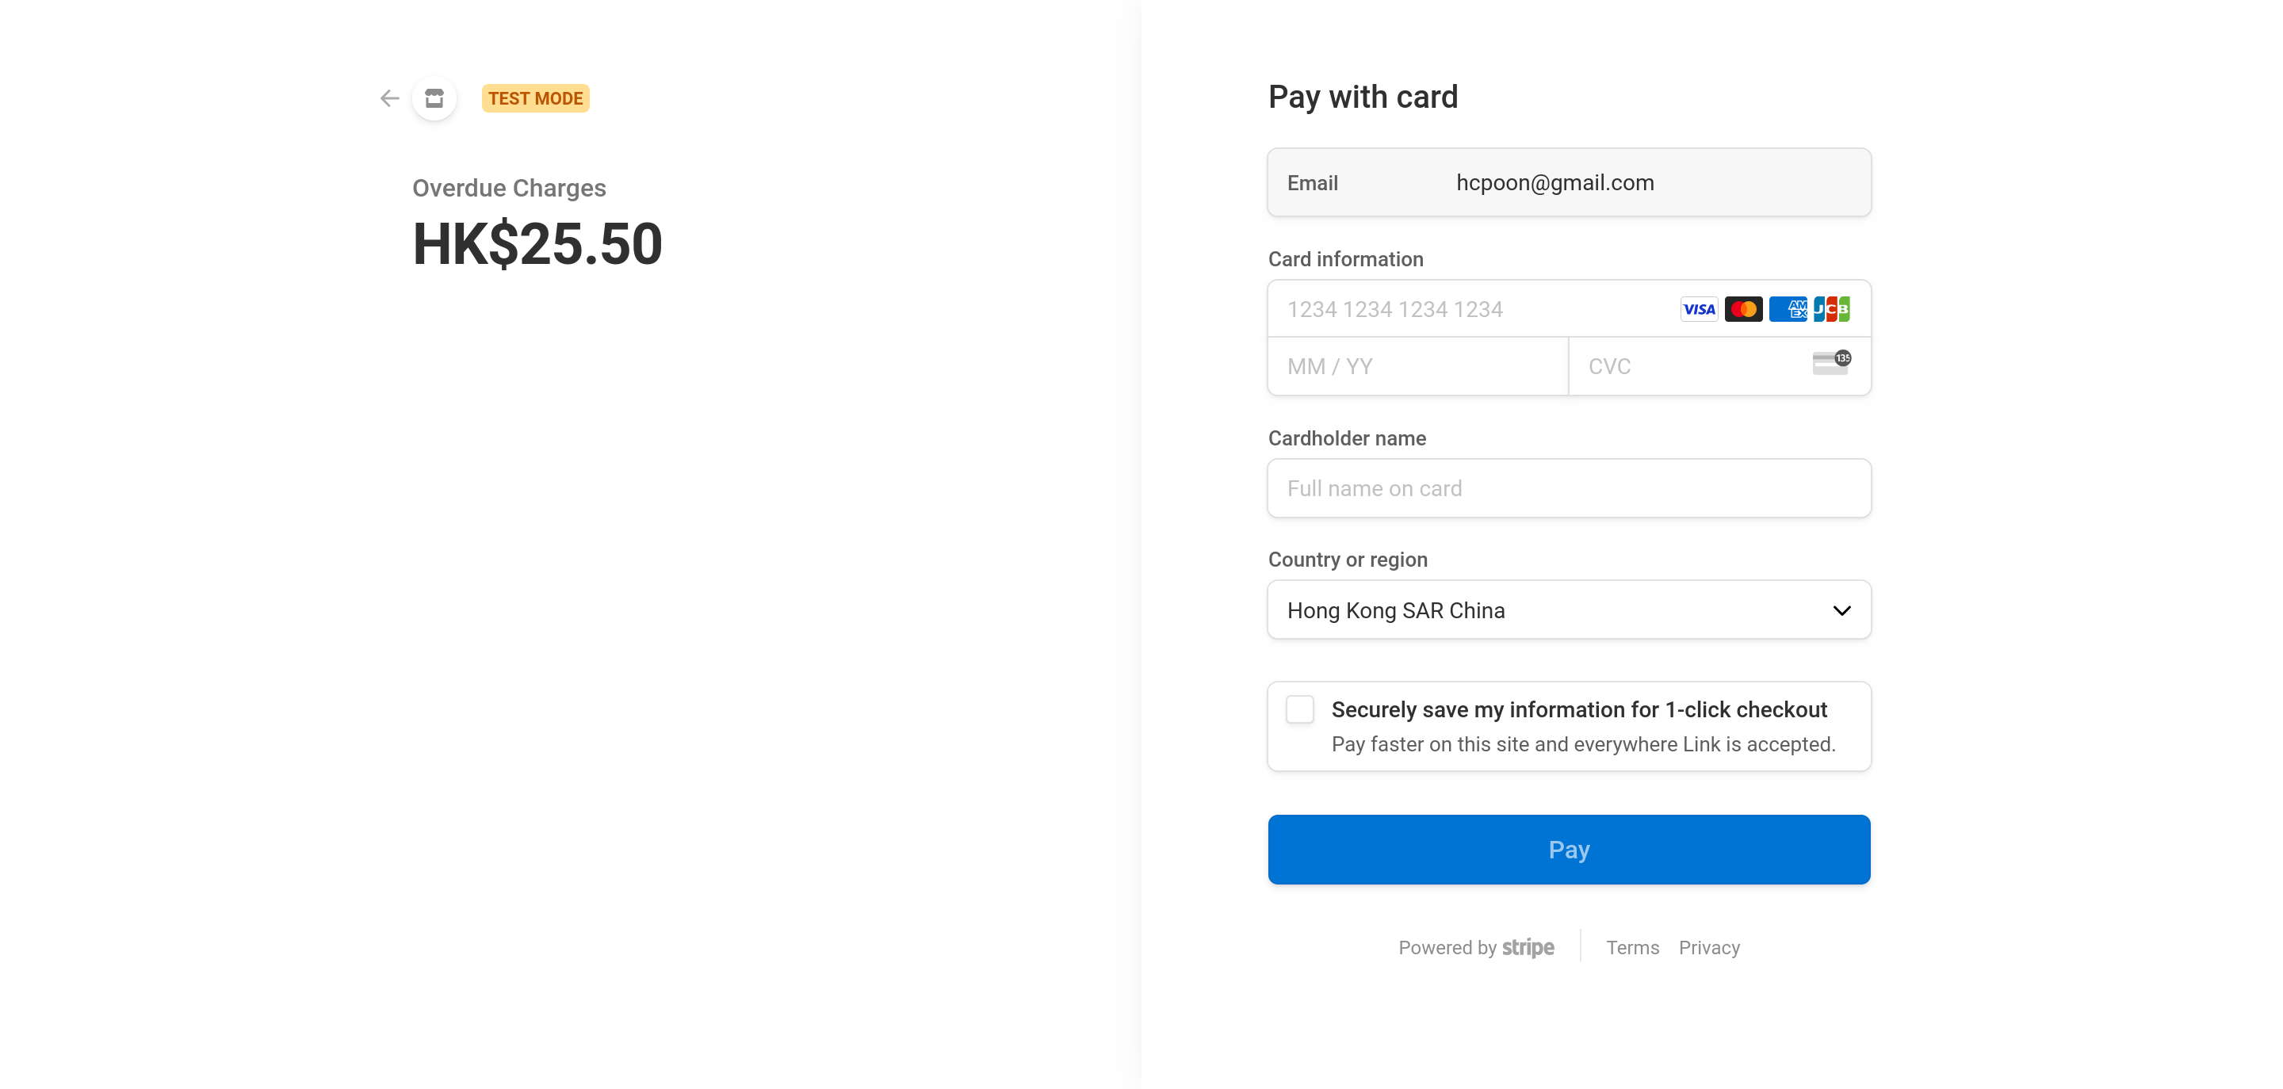

Slide 38


Slide 39
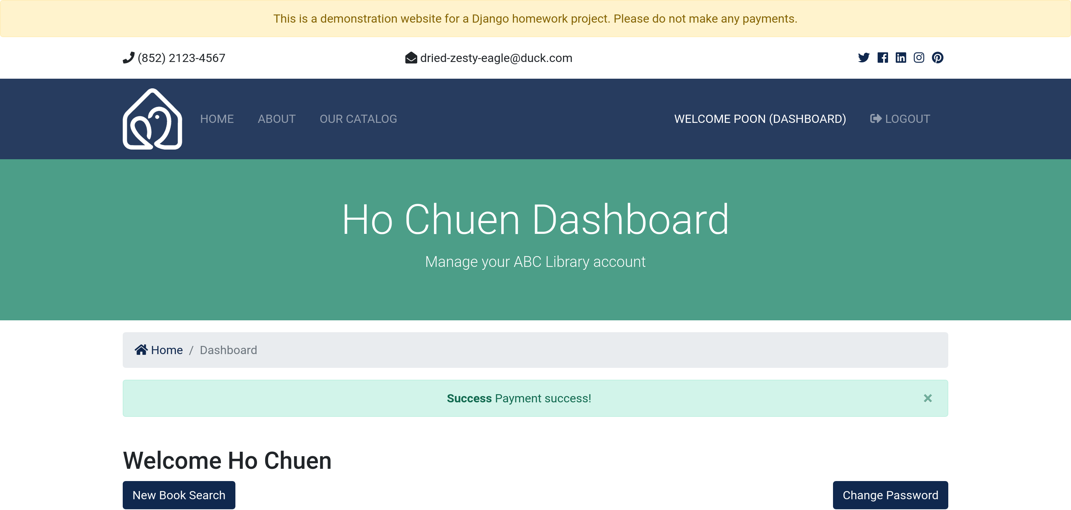

Slide 40
Thank you

Slide 41
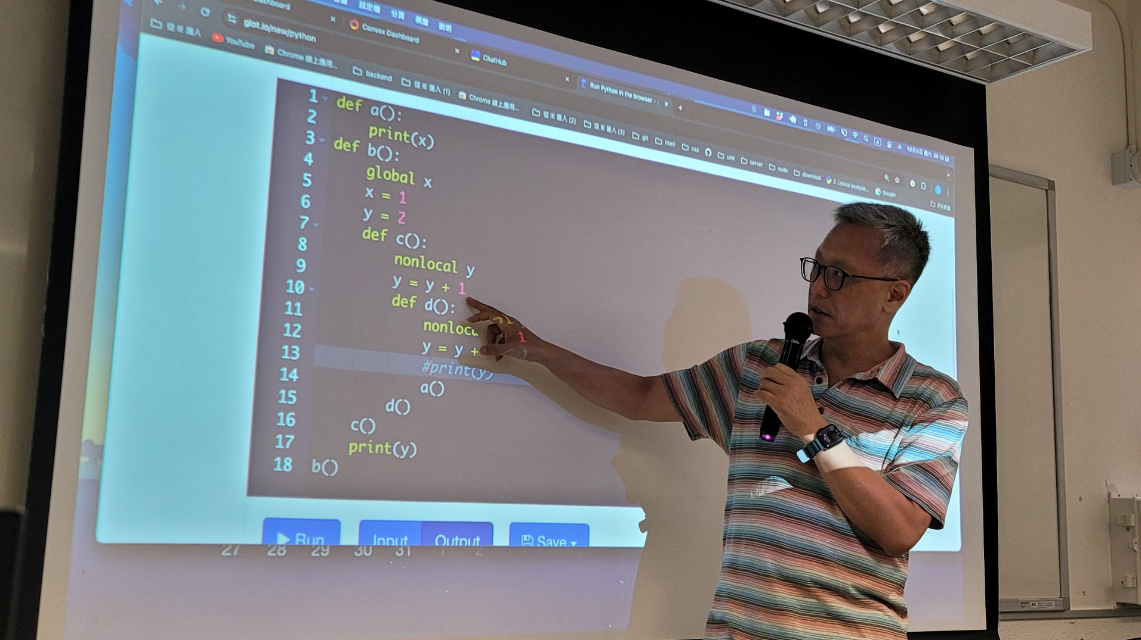
感謝衛Sir，這兩個月用心教導

